Slide 1
Introduction to Material Flow Analysis
Xiaohan Wu
6/25/2025
© 2026 Xiaohan Wu. All rights reserved.

Slide 2

Agenda
Self-Introduction and research overview
Roll call
Syllabus
Why we study material flow
Project group formation
ODYM installation

Slide 3





Northeastern University, Shenyang, China
B.E. in Energy and Power Engineering, School of Metallurgy
09/2018-06/2022
The University of Illinois at Chicago
Exchange Student in Mechanical Engineering, 08/2021-06/2022
Carnegie Mellon University
M.S. in Engineering & Public Policy, 08/2022-12/2023
“I develop and apply industrial ecology methods to evaluate and guide the sustainable production and recovery of critical materials”
Purdue University
Ph.D. in Environmental & Ecological Engineering, 01/2024-Now

Slide 4
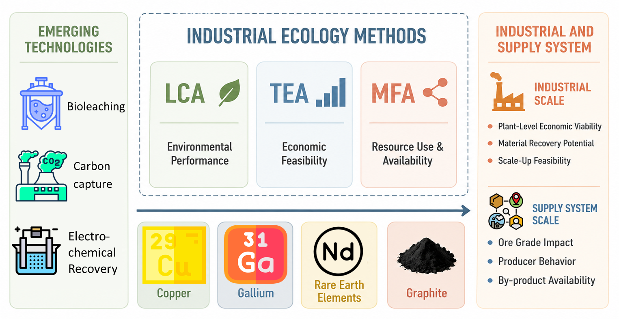
Research Overview

Slide 5

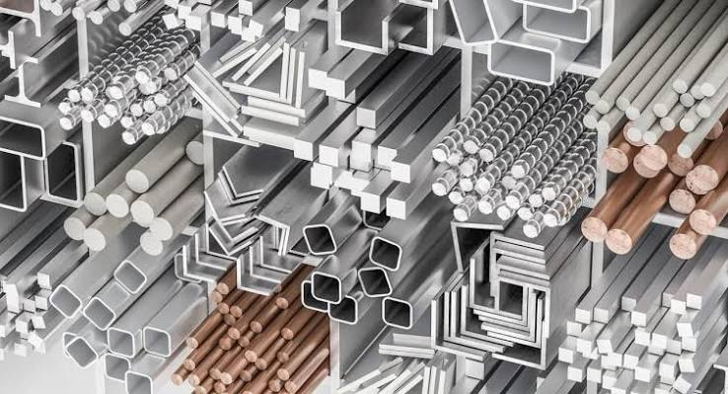
Lecture 1
Why do we study material flow?
Material
Flow

Slide 6

Lecture 1
Why do we study material flow?
Material Flow !

Slide 7
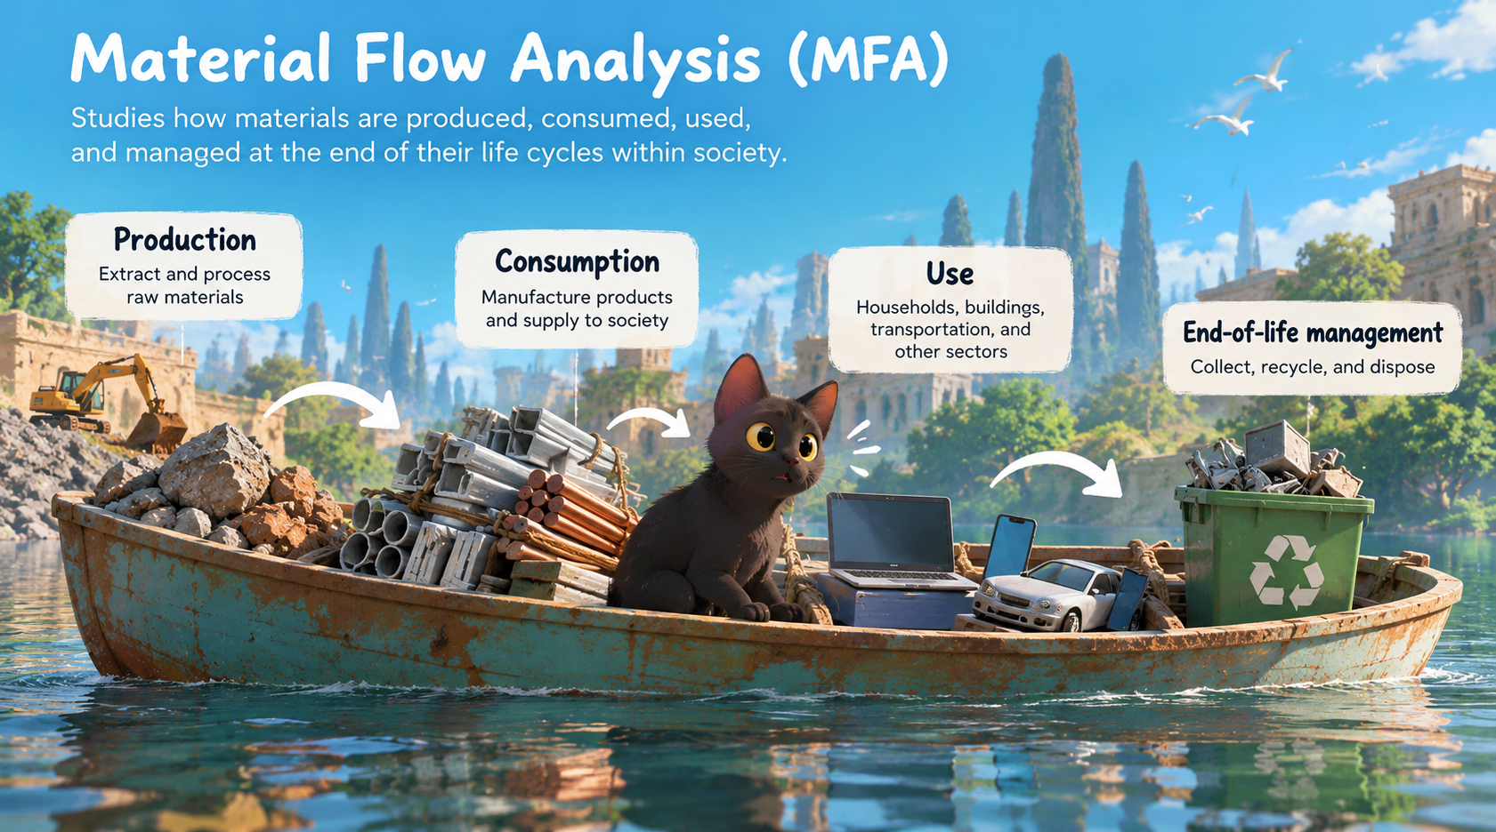
Lecture 1
Why do we study material flow?
Material Flow Analysis (MFA) is the study of how materials are produced, consumed, used, and managed at the end of their life cycles within society.

Slide 8

Lecture 1
Why do we study material flow?
“Industrial ecology is the means by which humanity can deliberately and rationally approach and maintain sustainability, given continued economic, cultural, and technological evolution. The concept requires that an industrial ecosystem be viewed not in isolation from its surrounding system, but in concert with them. It is a systems view in which one seeks to optimize the total materials cycle from virgin material, to finished material, to component, to product, to obsolete product, and to ultimate disposal. Factors to be optimized are resources, energy and capital” (Graedel, 1994).
https://is4ie.org/about/history

Slide 9
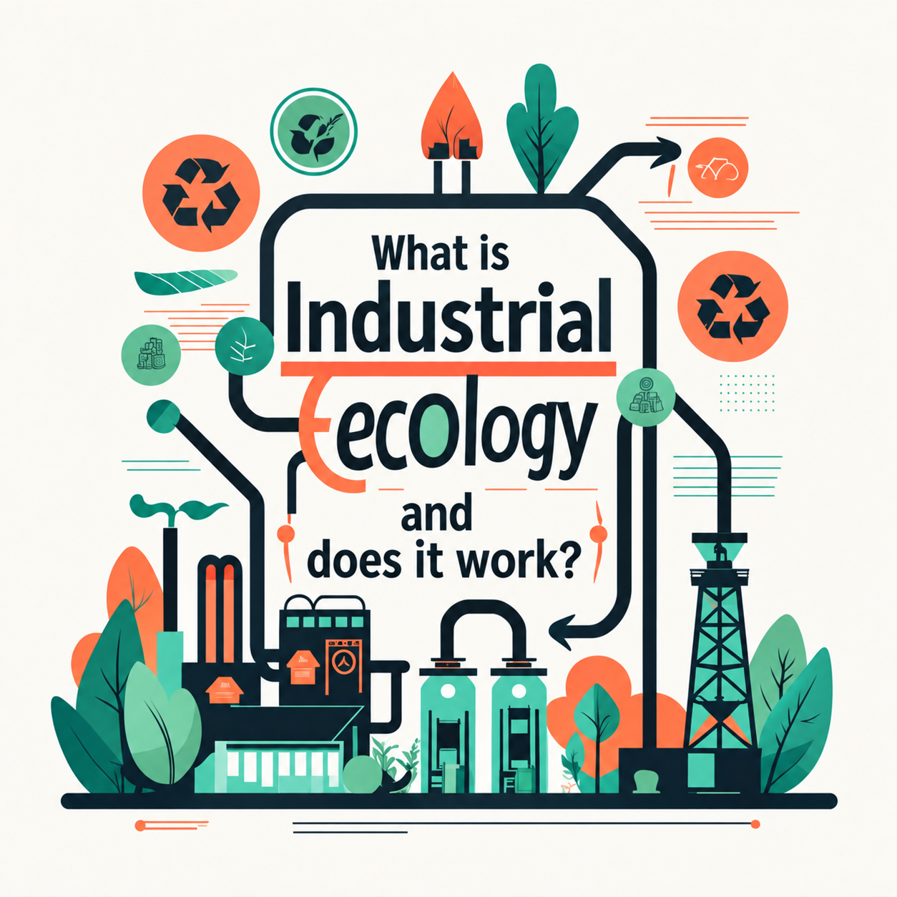
Lecture 1
Why do we study material flow?
“Industrial ecology (IE) is the study of industrial systems that operate more like natural ecosystems. A natural ecosystem tends to evolve in such a way that any available source of useful material or energy will be used by some organism in the system. Animals and plants live on each other's waste matter. Materials and energy tend to circulate in a complex web of interactions: animal wastes and dead plant material are metabolized by microorganisms and turned into forms that are useful nutrients for plants. The plants in turn may be eaten by animals or die, decay and go around the cycle again. These systems do, of course, leave some waste materials; otherwise we would have no fossil fuels. But on the whole the system regulates itself and consumes what it produces” (Frosch, 1994).
Frosch, R. A. (1994). Industrial ecology: Minimizing the impact of industrial waste. Physics Today, 47(11), 63–68.

Slide 10

Lecture 1
Why do we study material flow?
“Industrial ecology is the study of the flows of materials and energy in industrial and consumer activities, of the effects of these flows on the environment, and of the influences of economic, political, regulatory, and social factors on the flow, use, and transformation of resources” (White, 1994).
White, R. M. (1994). Preface. In B. R. Allenby & D. J. Richards (Eds.), The Greening of Industrial Ecosystems. National Academy Press. https://doi.org/10.17226/2129

Slide 11
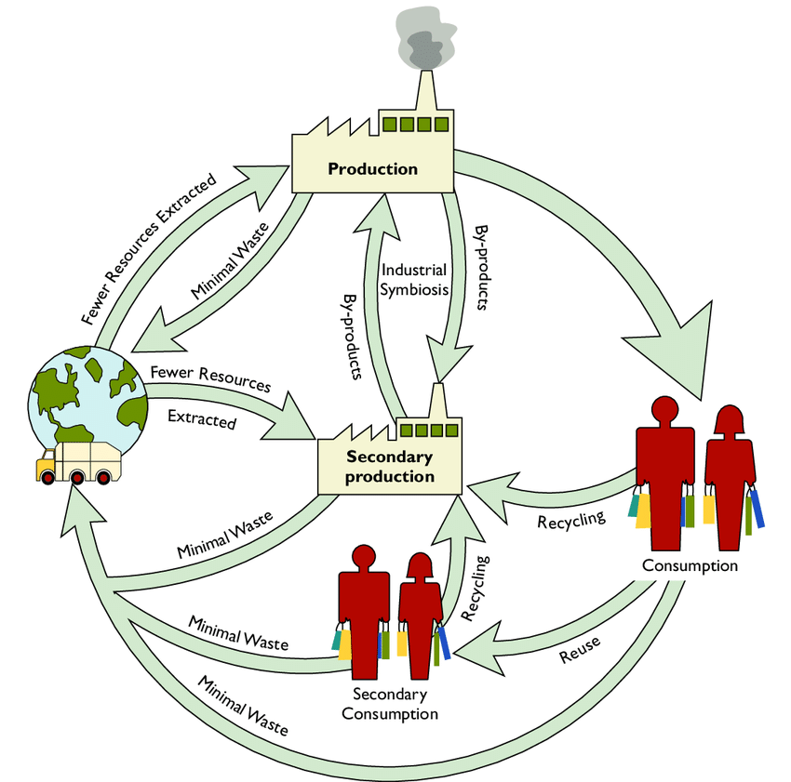
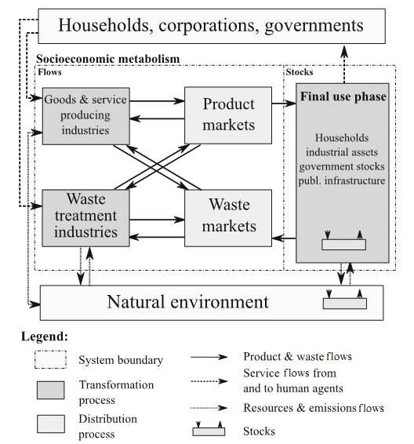
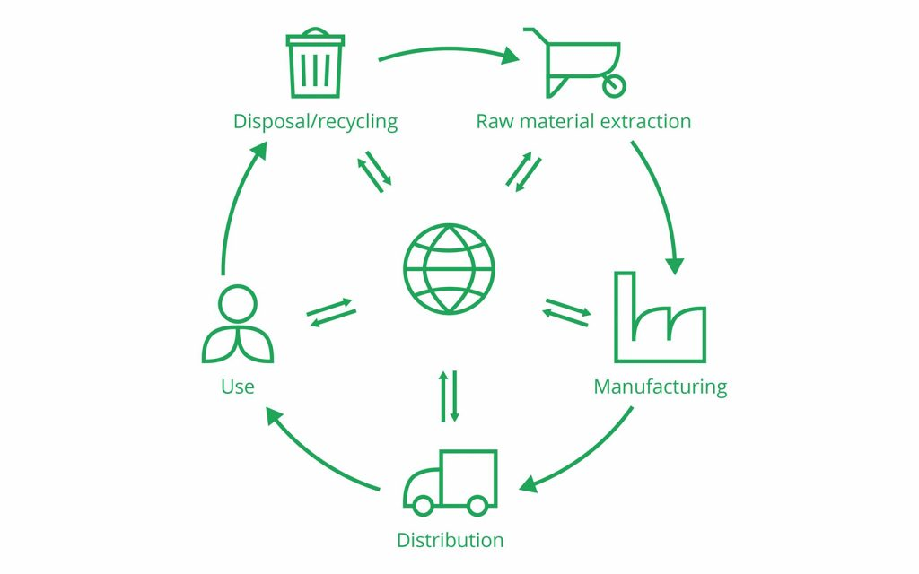
Lecture 1
“the study of the flows of materials and energy in industrial and consumer activities, of the effects of these flows on the environment, …economic, political, regulatory, and social factors on the flow…”
Why do we study material flow?
“seeks to optimize the total materials cycle from virgin material, to finished material…”
“industrial systems that operate more like natural ecosystems…”
(Graedel, 1994)
(Frosch, 1994)
(White, 1994)

Slide 12
Lecture 1
Why do we study material flow?
Life cycle assessment (LCA): evaluates the environmental impacts of a product or system across its life cycle, from raw material extraction to end-of-life
Techno-economic analysis: Evaluates the economic feasibility of a technology, process, or system by assessing its technical performance, costs, and revenues
Industrial ecology
Material flow analysis: Quantifies material inputs, outputs, internal flows, and stock changes within defined spatial and temporal boundaries, based on mass conservation

Slide 13
Lecture 1
Why do we study material flow?
Raw material
Intermediate processing stages
Finished product
Process 1
Process 2
Process n
Life cycle environmental impact of 1 ton/kg of material

Slide 14
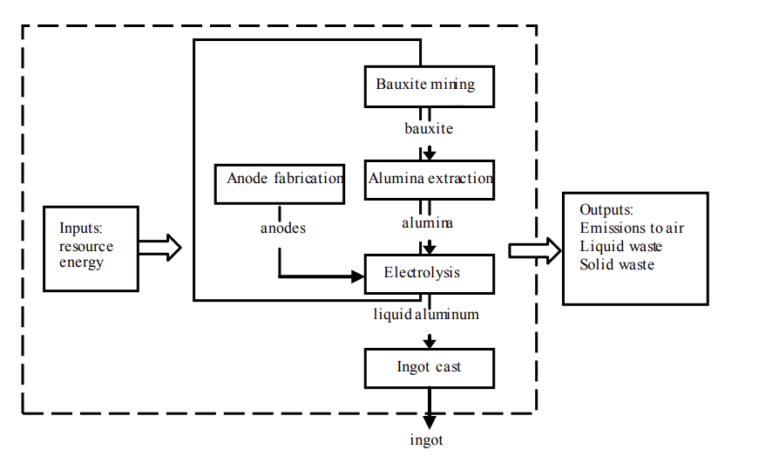
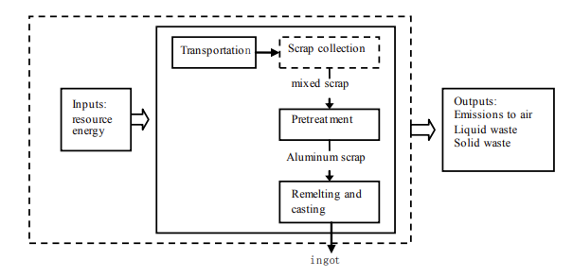
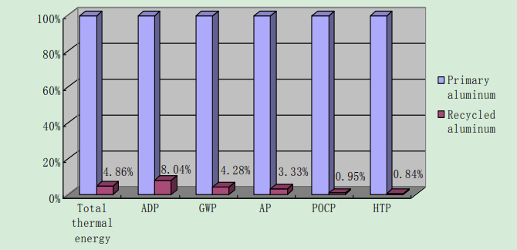
Lecture 1
Raw material
Finished product
Why do we study material flow?
Primary Aluminum Production
Secondary Aluminum Production
Why can’t we produce all aluminum from recycled aluminum?
Environmental Impacts of Primary vs. Recycled Aluminum
Ding, N., Gao, F., Wang, Z., Gong, X., & Nie, Z. (2012). Environmental impact analysis of primary aluminum and recycled aluminum. Procedia Engineering, 27, 465–474. https://doi.org/10.1016/j.proeng.2011.12.475

Slide 15
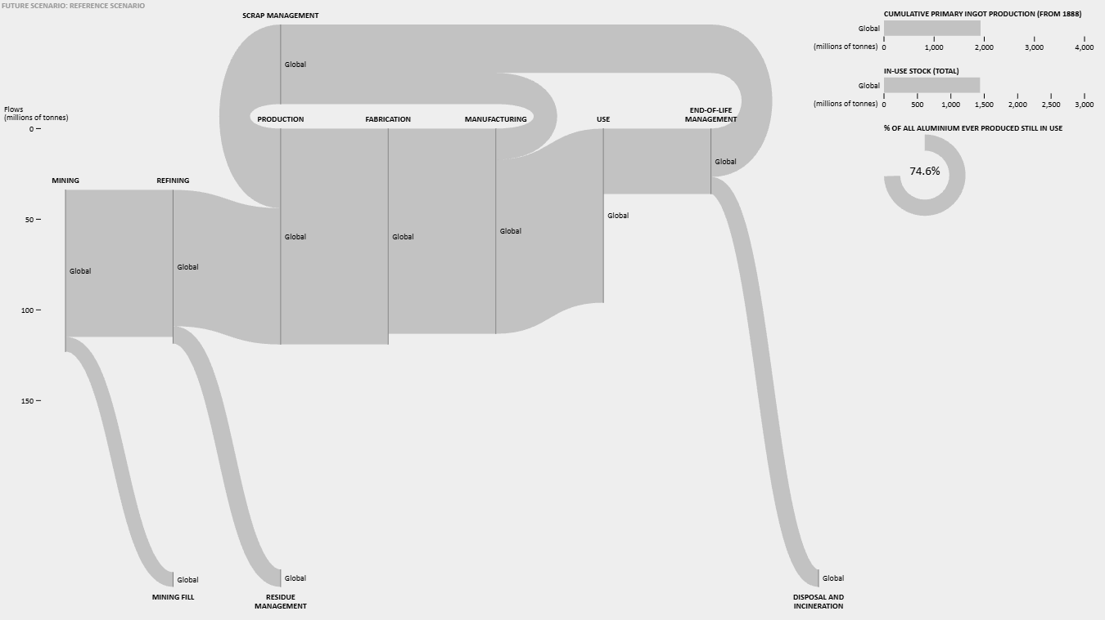
Global Aluminium Cycle 2025
International Aluminum Institute (IAI). (2026). Global Aluminum Cycle 2025. Global Aluminum Cycle database/visualization. Data updated January 12, 2026.
Al_Cycle

Slide 16
In-Class Exercise 1
Aluminum Stock Accumulation
Assumptions:
Annual aluminum production: 10 Mt/year
All aluminum enters society after production.
10% of the aluminum stock is discarded each year, including the year of production.
Question 1: How much aluminum produced in Year 1 remains in society at the end of Year 10?
Question 2: How much aluminum produced in from Year 2-10 remains at the end of Year 10?
Question 3: What is the total aluminum stock in society at the end of Year 10?
Notes:
Aluminium flow
Value
Input
12.0 t
In-use stock addition
7.2 t
Export
2.4 t
Inventory stock addition
2.4 t

Slide 17


In-Class Exercise 1
Aluminum Stock Accumulation
Assumptions:
Annual aluminum production: 10 Mt/year
All aluminum enters society after production.
10% of the aluminum stock is discarded each year, including the year of production.
Question 1: How much aluminum produced in Year 1 remains in society at the end of Year 10?
$$S_{1,10}=10×{\left(0.9\right)}^{10}$$
Question 2: How much aluminum produced in from Year 2-10 remains at the end of Year 10?
$$\begin{aligned}S_{2,10}&=10×{\left(0.9\right)}^{9} \\ S_{3,10}&=10×{\left(0.9\right)}^{8} \\ &⋮ \\ S_{10,10}&=10×{\left(0.9\right)}^{1}\end{aligned}$$
Question 3: What is the total aluminum stock in society at the end of Year 10?
$$\boxed{S_{10}=\sum_{i=1}^{10}{10}×{\left(0.9\right)}^{11−i}}$$
Notes:
Aluminium flow
Value
Input
12.0 t
In-use stock addition
7.2 t
Export
2.4 t
Inventory stock addition
2.4 t

Slide 18
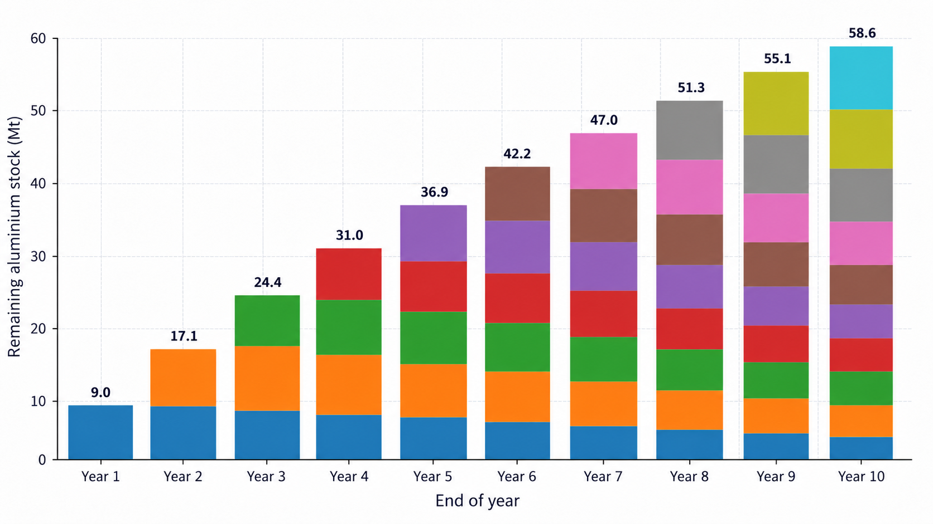
In-Class Exercise 1
Aluminum Stock Accumulation
Assumptions:
Annual aluminum production: 10 Mt/year
All aluminum enters society after production.
10% of the aluminum stock is discarded each year, including the year of production.
Notes:
Aluminium flow
Value
Input
12.0 t
In-use stock addition
7.2 t
Export
2.4 t
Inventory stock addition
2.4 t

Slide 19
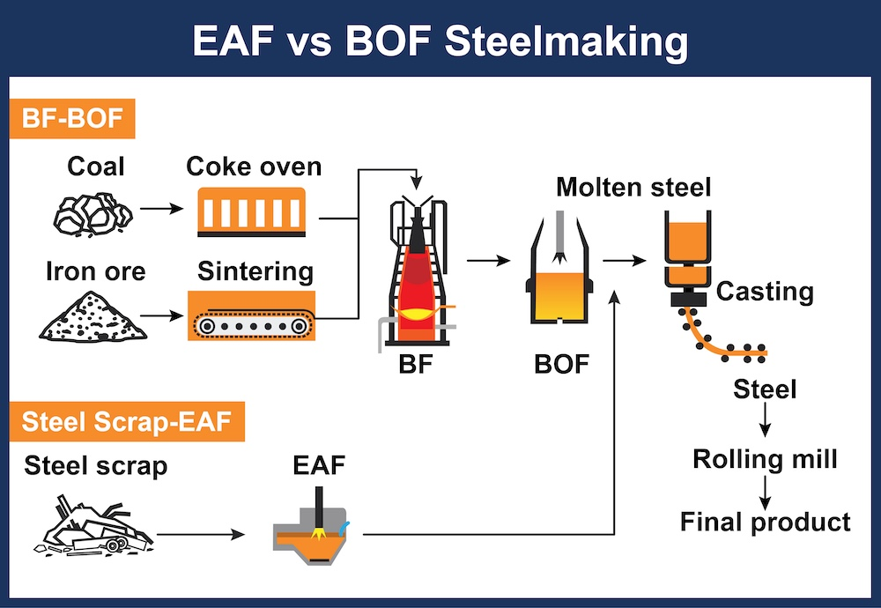
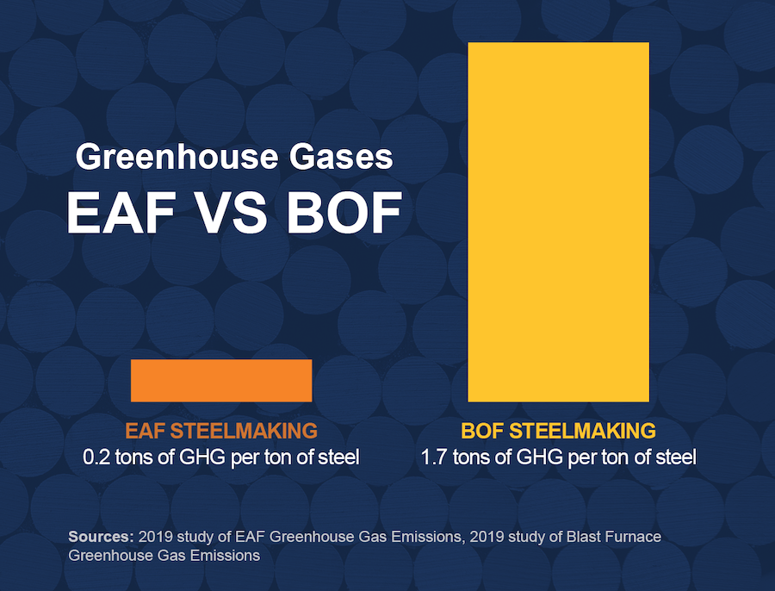
Lecture 1
Raw material
Finished product
Why do we study material flow?
EAF = Electric Arc Furnace
BF–BOF = Blast Furnace–Basic Oxygen Furnace
Why can’t we produce all steel from steel scrap?
Charter Steel. (2024). EAF vs. BOF furnaces in sustainable steelmaking. January 31, 2024

Slide 20
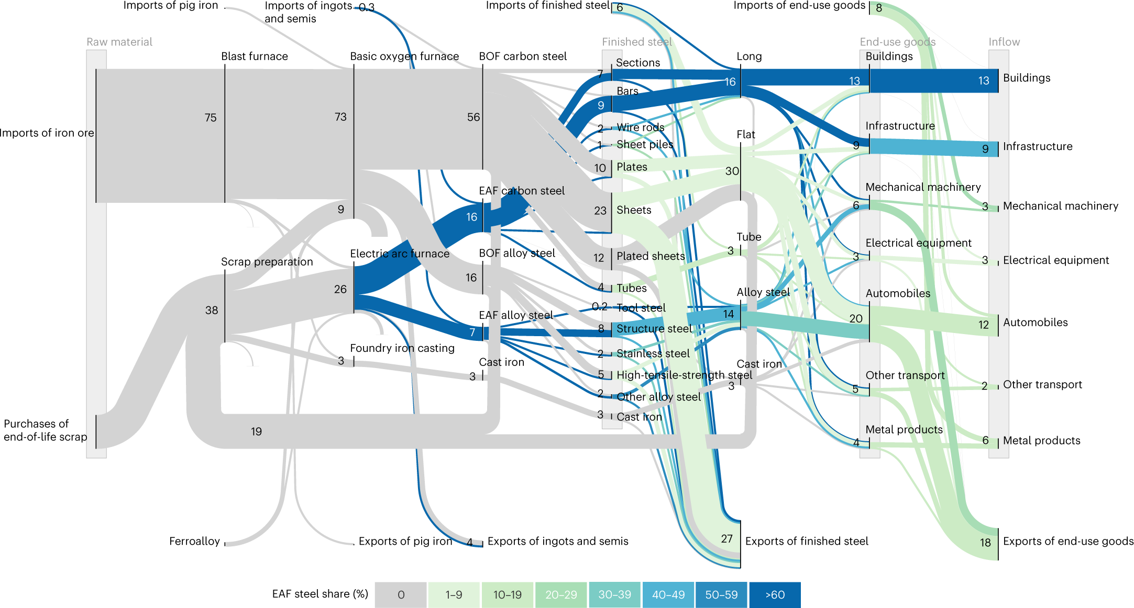
Lecture 1
Raw material
Finished product
Why do we study material flow?
Watari, T., Hata, S., Nakajima, K., & Nansai, K. (2023). Limited quantity and quality of steel supply in a zero-emission future. Nature Sustainability, 6, 336–343. https://doi.org/10.1038/s41893-022-01025-0

Slide 21
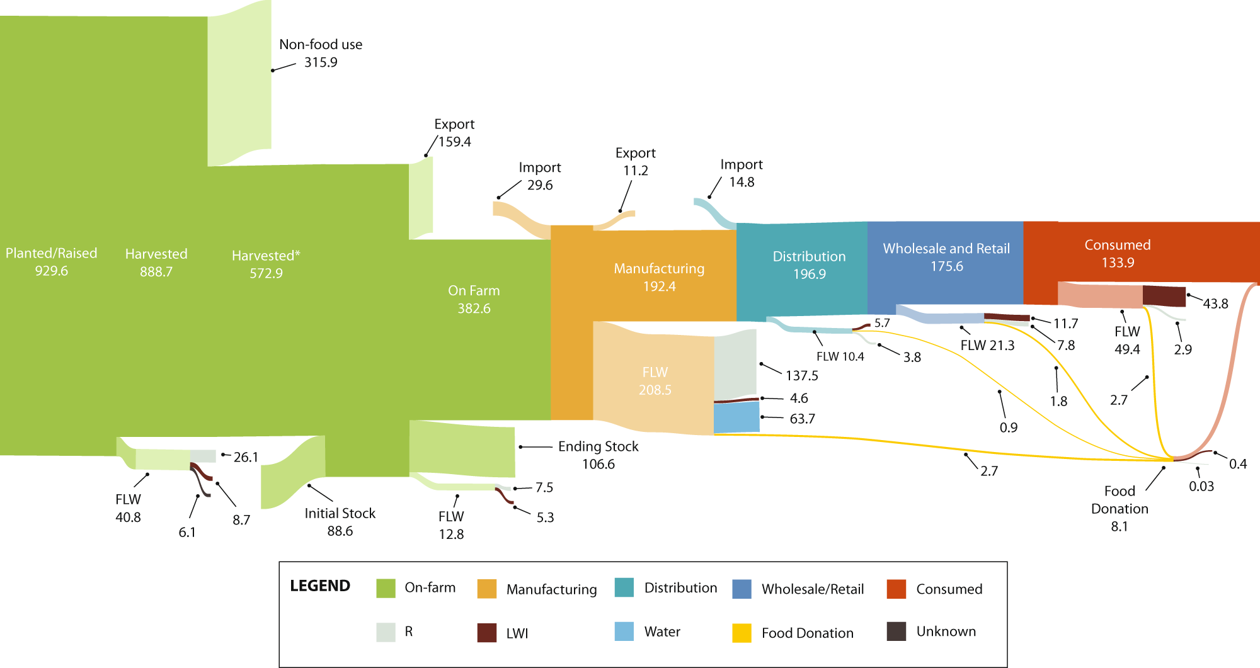
Lecture 1
Raw material
Finished product
Why do we study material flow?
To figure out when the waste material will occur
FSC: Food Supply Chain
FLW: Food Loss and Waste
Sankey diagram of the mass flows of the 2016 U.S. FSC (in MMT)
Dong, W., Armstrong, K., Jin, M., Nimbalkar, S., Guo, W., Zhuang, J., & Cresko, J. (2022). A framework to quantify mass flow and assess food loss and waste in the US food supply chain. Communications Earth & Environment, 3, Article 83. https://doi.org/10.1038/s43247-022-00414-9

Slide 22
Lecture 1
Project Group Formation
Form a group
1
Work with 3–4 students.
Get to know each other
2
Introduce yourselves and exchange contact information.
TEAM SIZE
3–4 students
Explore project interests
3
Discuss MFA topics you might like to study.
IN-CLASS TIME
Record your team
5 minutes
4
Write down the names of all group members and send them to wu2213@purdue.edu

Slide 23
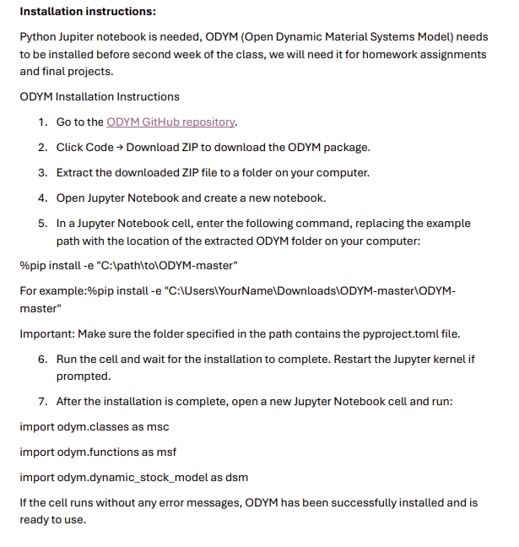
Lecture 1
ODYM installation

Slide 24
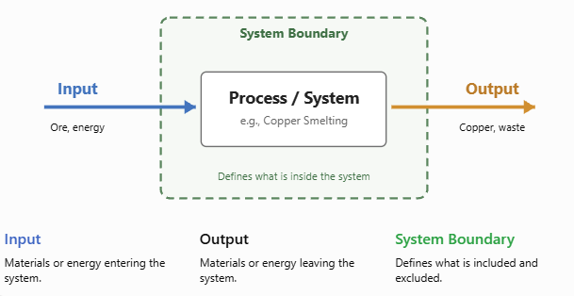
Lecture 2
Inputs, Outputs, Stock, and System Boundaries

Slide 25


Lecture 2
Inputs, Outputs, Stock, and System Boundaries
Process/system
$$\text{Input}$$
$$\text{Output}$$
$$\text{Δ}s\text{tock}$$

Slide 26
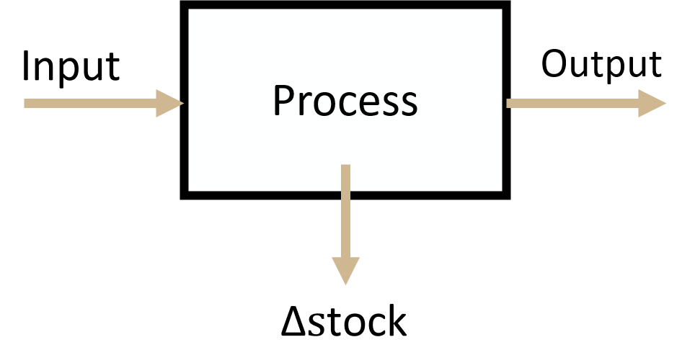
Lecture 2
Inputs, Outputs, Stock, and System Boundaries
System / Process | Input | Output | Stock
Copper mine | Copper ore | Copper concentrate, waste rock | Ore stockpile
Battery use in EVs | New batteries | Retired batteries | Batteries currently installed in EVs
University campus | Food, paper, chemicals, equipment | Waste, wastewater, recyclables | Materials embodied in buildings, furniture, and equipment
Wastewater treatment plant | Wastewater | Treated water, sludge | Water and solids temporarily retained in treatment tanks

Slide 27
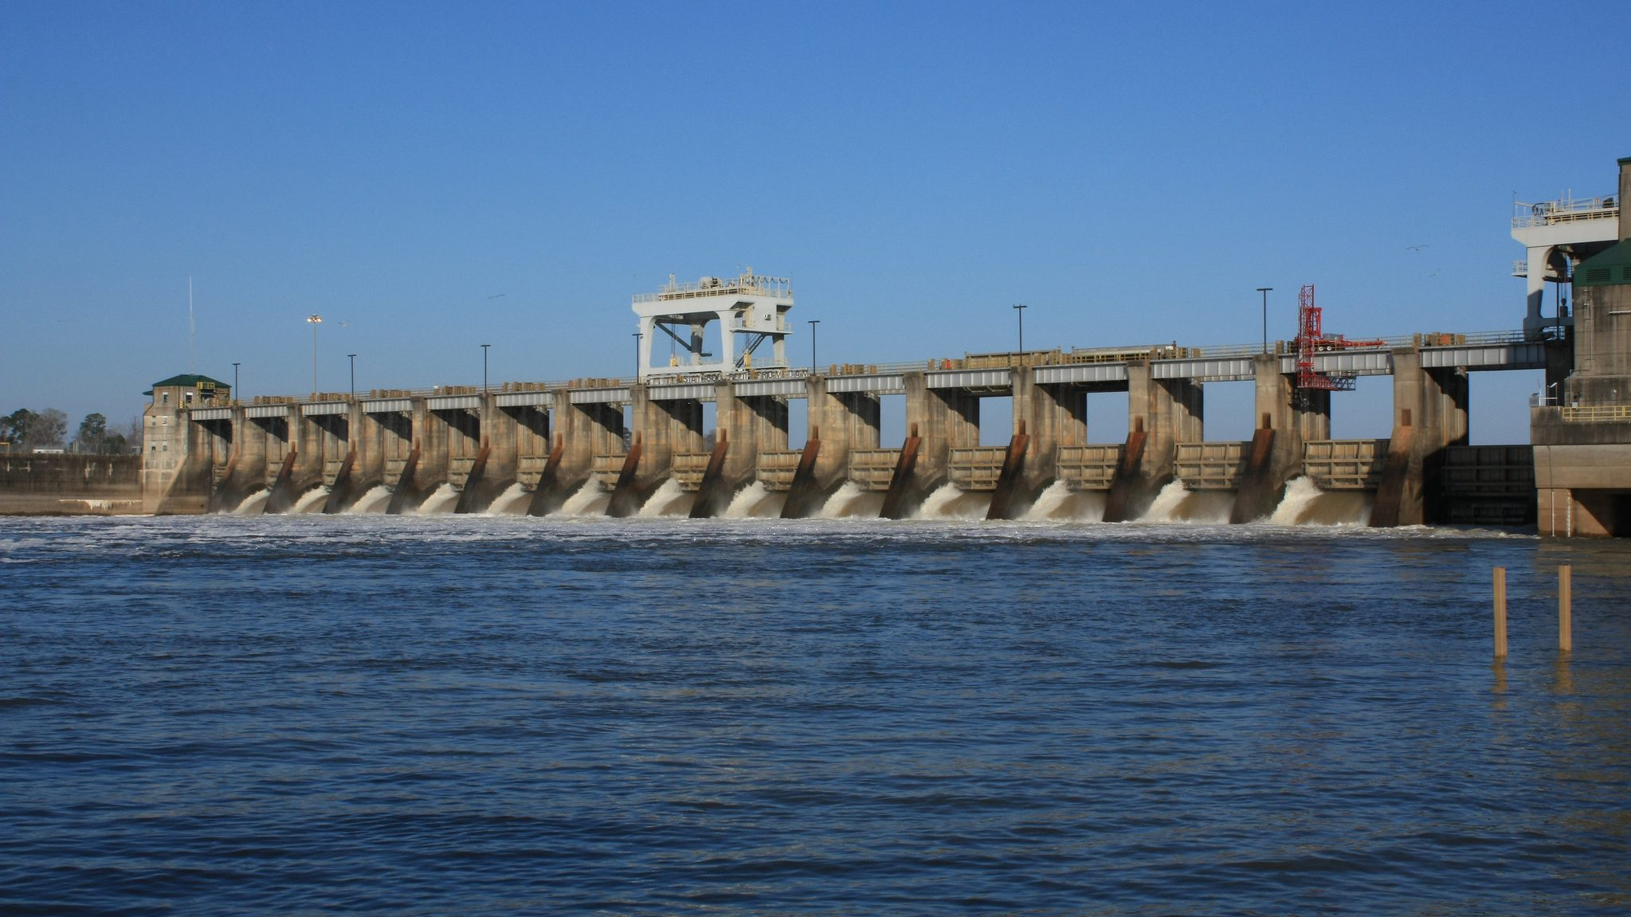
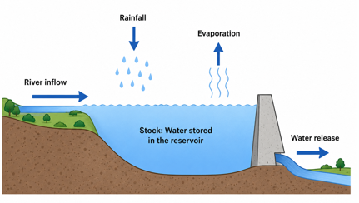
Lecture 2
Inputs, Outputs, and System Boundaries
System / Process | Input | Output | Stock
Reservoir | River inflow, rainfall | Water release, evaporation | Water stored in the reservoir

Slide 28
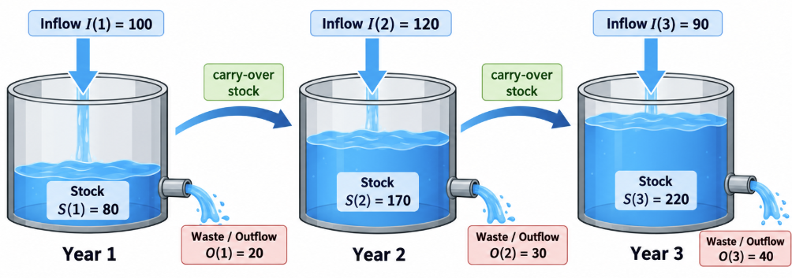
Lecture 2

Slide 29
Lecture 2
Inputs, Outputs, and System Boundaries
Boundary dimension | Key question | Example
Spatial boundary | Where? | USA, Indiana, a mine, a plant
Temporal boundary | When? | 2025; 2020–2050
Process boundary | Which processes are included? | Mining → Concentration → Smelting
Material boundary | What material is tracked? | Cu, Ga, plastics, water
The system boundary determines which flows are internal and which flows cross the boundary as inputs or outputs.

Slide 30
In-Class Exercise 1
Exercise 1 — Where Does an EV Battery Belong?
Scenario:
In 2025, Indiana purchases 1,000 electric vehicles manufactured in China. Each EV battery contains 8 kg of lithium. A researcher conducts an MFA of lithium in Indiana.
Questions:
How much lithium enters Indiana in 2025?
Should lithium mining in China be included in the system boundary?
Is the lithium inside the vehicles an input, an output, or a stock?
What changes if the spatial boundary is expanded from Indiana to the entire world?
Notes:
Aluminium flow
Value
Input
12.0 t
In-use stock addition
7.2 t
Export
2.4 t
Inventory stock addition
2.4 t

Slide 31
In-Class Exercise 2
Exercise 2 — Are We Tracking Solar Panels or Aluminum?
Scenario:
In 2025, a city imports 100 tones of solar panels. Aluminum accounts for 12% of their total mass. By the end of the year: 60 tones of panels are installed locally. 20 tones are exported. 20 tones remain in storage.
Questions:
If we track aluminum only, what is the material input?
How much aluminum enters the city's in-use stock?
How much aluminum is exported?
What is the difference between in-use stock and inventory stock?
Notes:
Aluminium flow
Value
Input
12.0 t
In-use stock addition
7.2 t
Export
2.4 t
Inventory stock addition
2.4 t

Slide 32
In-Class Exercise 3
Exercise 3 — Can a Material Be an Input and an Output at the Same Time?
Scenario:
An aluminum recycling facility receives 100 tones of scrap.
75 t goes to the local remelting plant.
15 t is exported.
10 t becomes sorting residue.
The remelting plant produces 68 t of secondary aluminum and 7 t of dross.
Questions:
Draw the material flow diagram.
Is the 75 t scrap an output when studying only the sorting facility?
Is it still an external output if the boundary includes both sorting and remelting?
What is the overall recovery yield?
Notes:
Aluminium flow
Value
Input
12.0 t
In-use stock addition
7.2 t
Export
2.4 t
Inventory stock addition
2.4 t

Slide 33
In-Class Exercise 4
Exercise 4 — Does Extending Product Lifetime Reduce Waste?
Scenario:
In 2025, a city installs 1,000 tonnes of copper in new buildings.
Consider two scenarios:
Scenario A: Buildings last 30 years.
Scenario B: Buildings last 50 years.
Assume all the copper is discarded at the end of its building's lifetime.
Questions:
How much of this copper remains in use in 2045?
How much reaches end-of-life in 2055?
Which scenario makes more recycled copper available by 2055?
Is a longer lifetime always beneficial for recycling?
Notes:
Aluminium flow
Value
Input
12.0 t
In-use stock addition
7.2 t
Export
2.4 t
Inventory stock addition
2.4 t

Slide 34
In-Class Exercise 5
Exercise 5 — Is Energy an Input in a Copper MFA?
Scenario:
A copper processing facility consumes:
1,000 t copper concentrate
5,000 MWh electricity
200 t diesel
100 t sulfuric acid
It produces copper cathodes, tailings and other waste streams.
Questions:
Which inputs should be included in an MFA tracking copper only?
What changes if the study tracks all material inputs?
Should electricity consumption be included?
How would the system boundary differ for an LCA study?
Notes:
Aluminium flow
Value
Input
12.0 t
In-use stock addition
7.2 t
Export
2.4 t
Inventory stock addition
2.4 t

Slide 35
In-Class Exercise 6
Exercise 6 — Why Does the Reported Recycling Rate Change?
Scenario:
A city generates 100 tonnes of end-of-life aluminum products.
80 t is collected for recycling.
60 t is successfully recovered as secondary aluminum.
20 t is lost during sorting and recycling.
20 t is sent directly to disposal.
Questions:
Calculate the collection rate.
Calculate the recycling efficiency of the collected material.
Calculate the overall end-of-life recycling rate.
Why are these three indicators different?
Notes:
Aluminium flow
Value
Input
12.0 t
In-use stock addition
7.2 t
Export
2.4 t
Inventory stock addition
2.4 t

Slide 36
Lecture 3
Inputs, Outputs, and System Boundaries
Matching Exercise: Inputs, Processes, and Outputs
Main Input | Process | Main Output
Ni in EOL EVs | Mining | Ni in LIBs
Ni in LIB precursors | Processing | Ni in concentrate
Ni in ore | Manufacture | Ni in EOL EVs
Ni in LIBs | Applications | Ni in recycled LIBs
Ni in concentrate | Use | Ni in EVs
Ni in EVs / battery scrap | Waste Management | Ni in ore

Slide 37
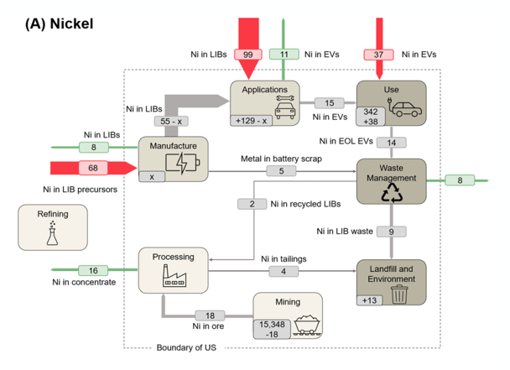
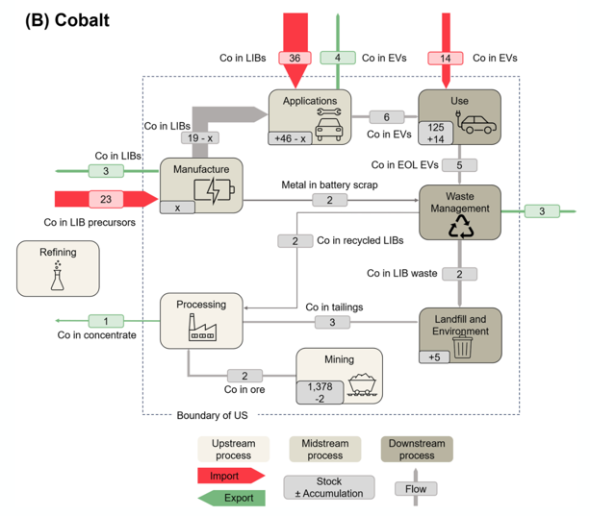
Lecture 3
Grayce Gibbs, Jihye Kim, Elizabeth Holley, Nicole Smith, Material flow analysis of present and projected production chains of US nickel and cobalt for lithium-ion batteries, Resources, Environment and Sustainability,
Volume 25, 2026, 100325, ISSN 2666-9161, https://doi.org/10.1016/j.resenv.2026.100325.

Slide 38
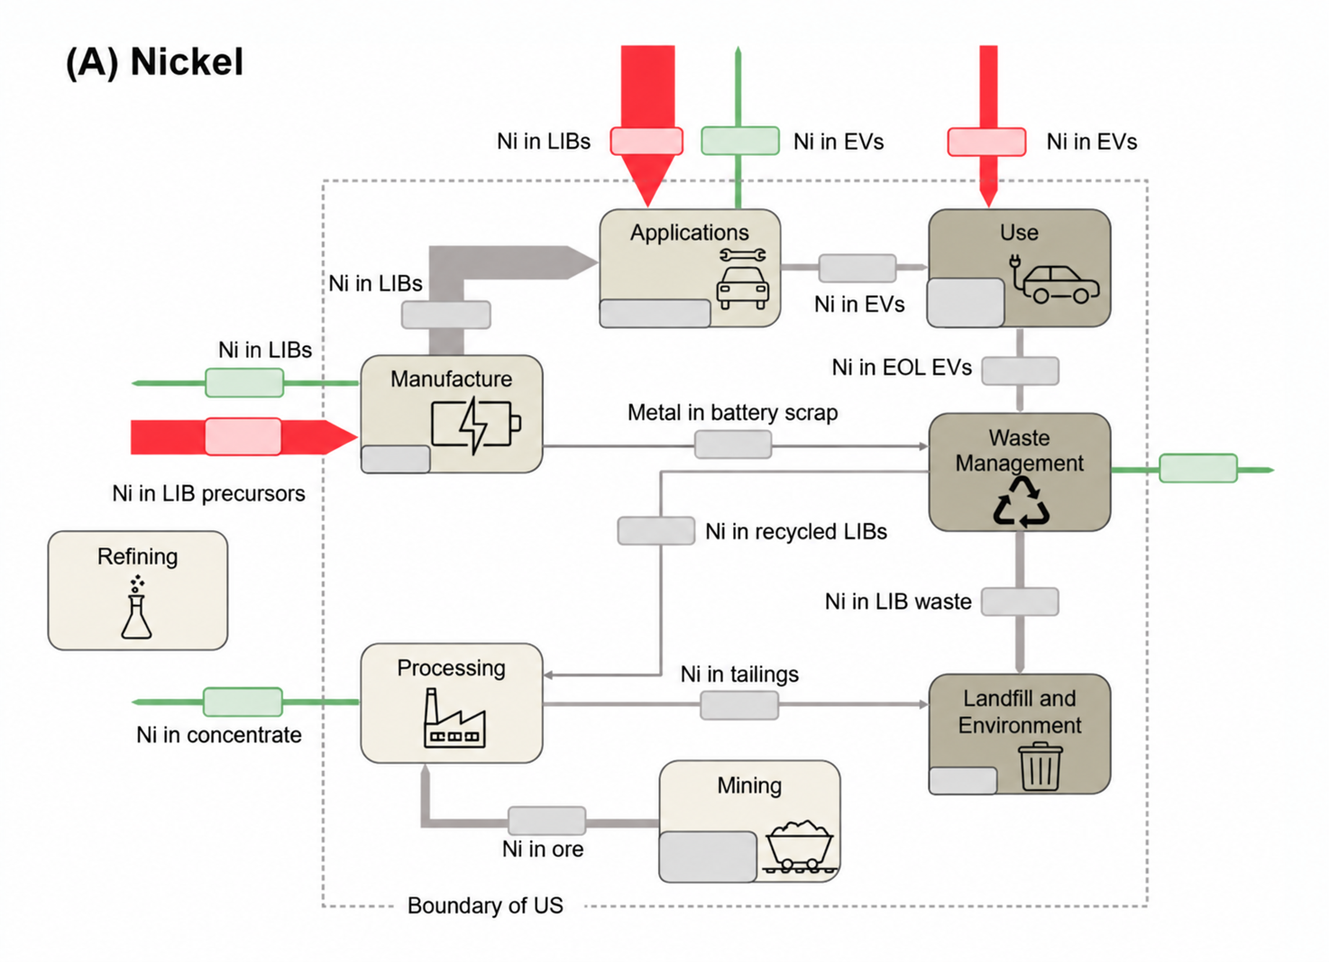
In-class Question: Mass Balance with an Unknown Stock
The figure below shows part of the U.S. nickel flow associated with lithium-ion batteries
For the Manufacturing process:
Given:
Nickel imported in LIB precursors = 68 kt
Nickel exported in LIBs = 8 kt
Nickel sent to battery scrap = 5 kt
Question:
How much nickel in LIBs flows from Manufacturing to Applications? For the For the For the Waste Management process:
Nickel in EOL EVs = 14 kt
Nickel in manufacturing scrap = 5 kt
Nickel recycled/exported = 8 kt
Nickel in recycled LIBs sent to Processing = 2 kt
Question:
How much nickel is sent from Waste Management to Landfill and Environment?

Slide 39
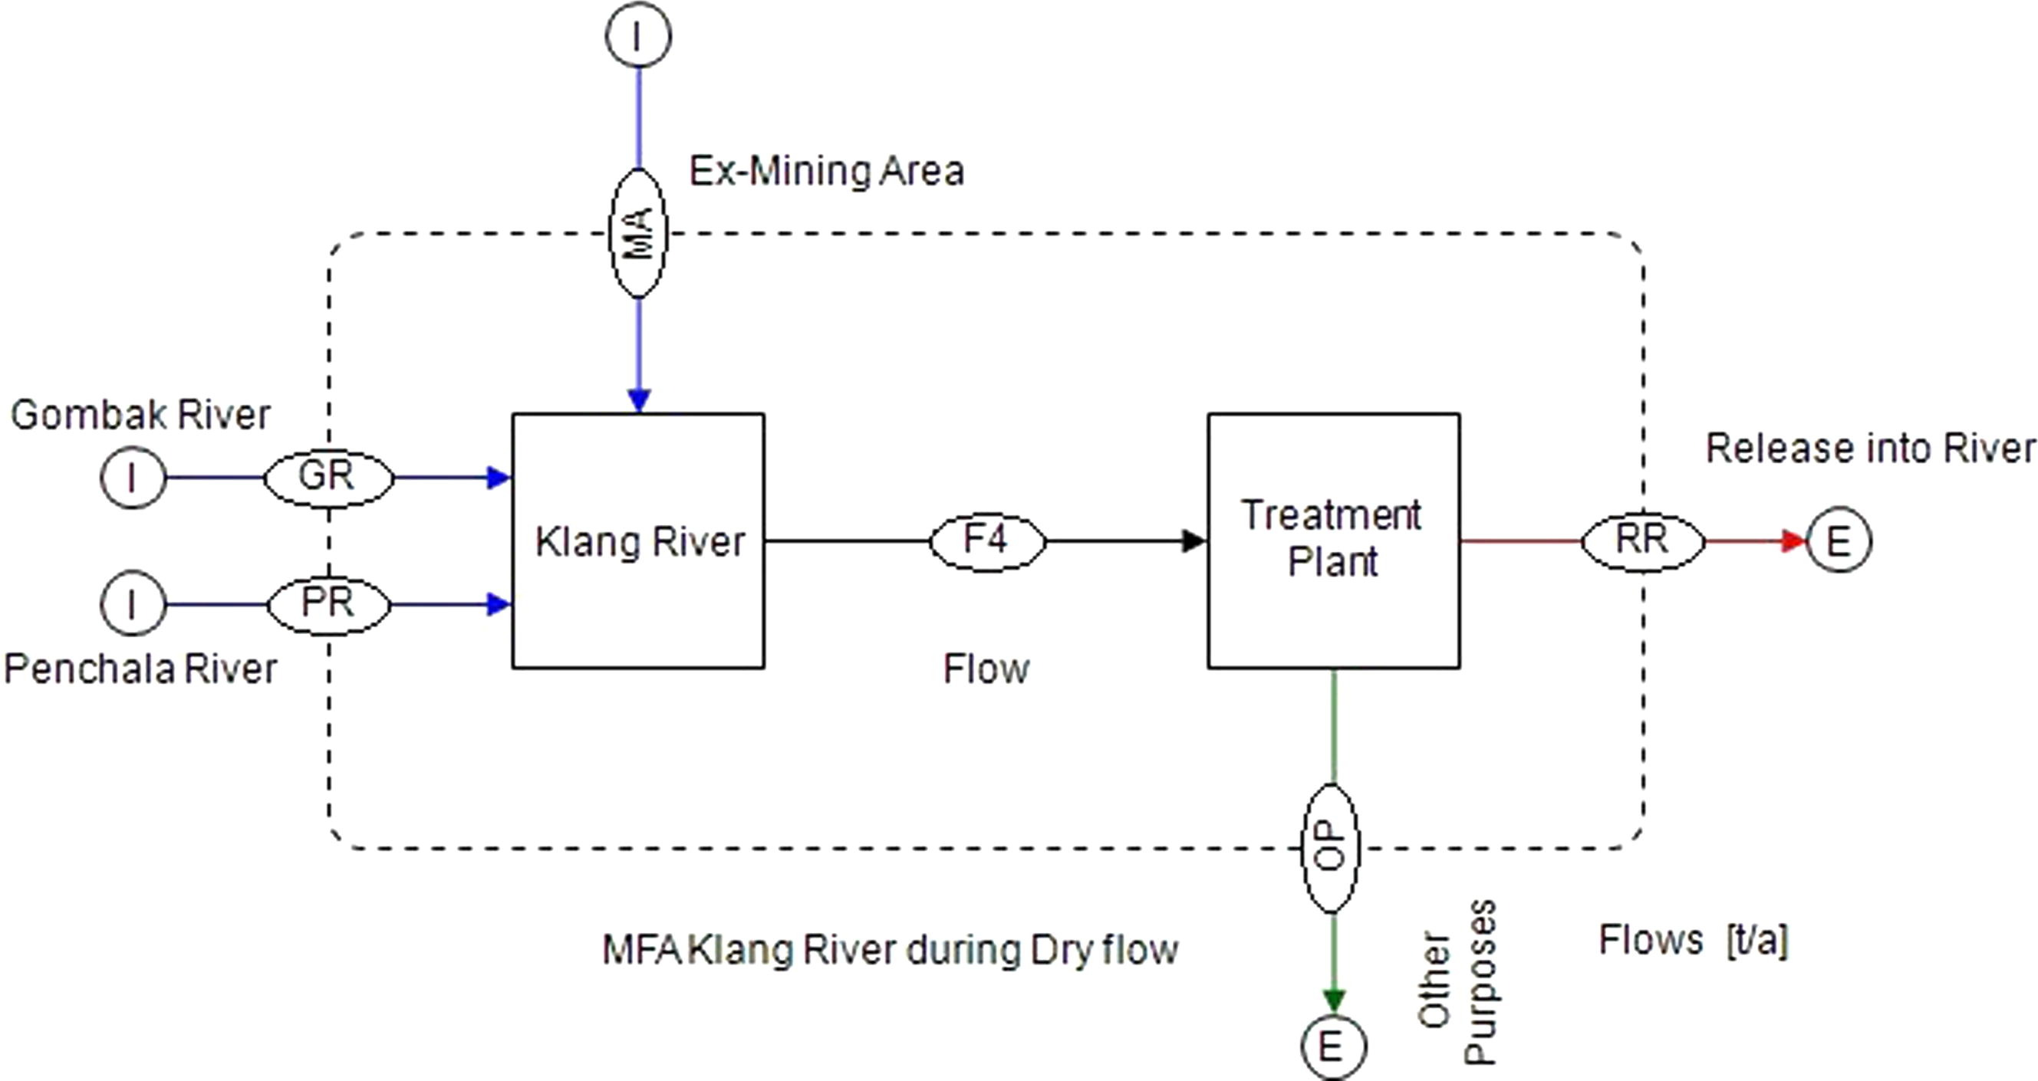
The Klang River wastewater system receives heavy metals from three major sources during the dry season:
Case Study: Heavy Metal Flows in a Wastewater System
Source | Heavy metal input
Gombak River | 857,074 kg/year
Penchala River | 2,377,423 kg/year
Ex-mining ponds | 583,050 kg/year

Slide 40

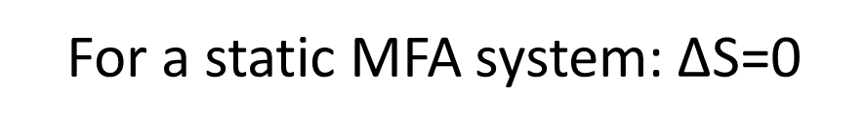
Lecture 3
Static MFA
$$\text{I=O+ΔS}$$
$$\text{Input=Output+}\text{Δ}s\text{tock}$$
Material accumulated within the system
Material entering the system
Material leaving the system
For a static MFA system: $\text{ΔS}\text{=0}$

Slide 41
Lecture 3
Input, output, and stock
$$\text{S(t+1)=S(t)+I(t)−O(t)}$$
Stock at the end of the time step t
Outflow during time step t
Inflow during time step t
Stock at the beginning of the time step t

Slide 42

Lecture 3
Input, output, and stock
$$S\left(t_{0}\right)=S_{\text{initial}}$$
$$S\left(t_{0}+1\right)=S\left(t_{0}\right)+I\left(t_{0}+1\right)−O\left(t_{0}+1\right)$$
$$S\left(t_{0}+2\right)=S\left(t_{0}+1\right)+I\left(t_{0}+2\right)−O\left(t_{0}+2\right)$$
$$S\left(t_{0}+2\right)=S\left(t_{0}\right)+\left[I\left(t_{0}+1\right)−O\left(t_{0}+1\right)\right]+\left[I\left(t_{0}+2\right)−O\left(t_{0}+2\right)\right]$$

Slide 43
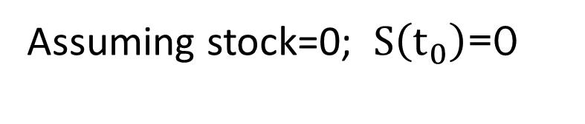
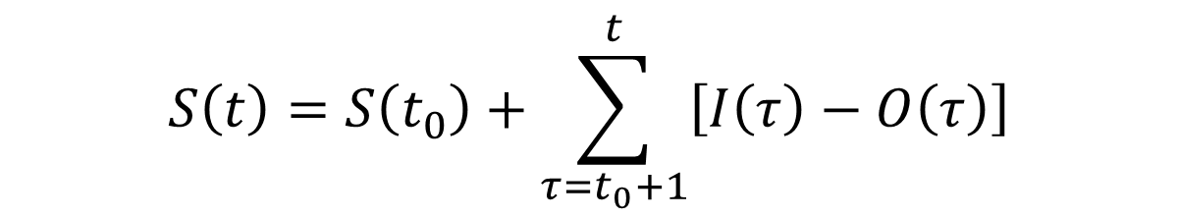

Lecture 2
Input, output, and stock
$$S\left(t\right)=S\left(t_{0}\right)+\sum_{τ=t_{0}+1}^{t}{\left[I\left(τ\right)−O\left(τ\right)\right]}$$
Assuming stock=0; $S\left(t_{0}\right)$=0
$$S\left(t\right)=\sum_{τ=t_{0}+1}^{t}{\left[I\left(τ\right)−O\left(τ\right)\right]}$$

Slide 44
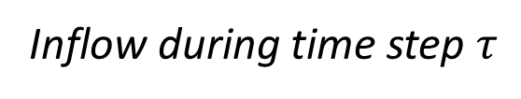
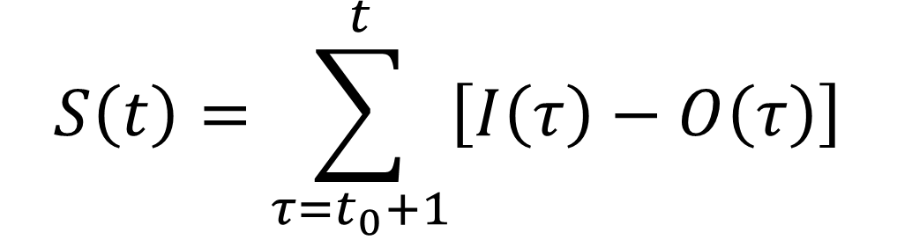
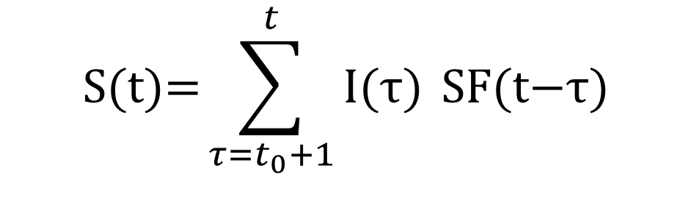
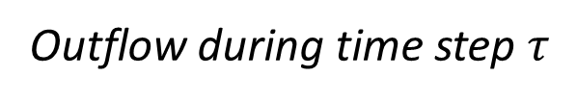
Lecture 3
Input, output, and stock
$$S\left(t\right)=\sum_{τ=t_{0}+1}^{t}{\left[I\left(τ\right)−O\left(τ\right)\right]}$$
Outflow during time step $τ$
Stock at time t
Inflow during time step $τ$
$$\text{S(t)=}\sum_{τ=t_{0}+1}^{t}{\text{I(}\text{τ)} }\text{SF(t−}\text{τ)}$$

Slide 45
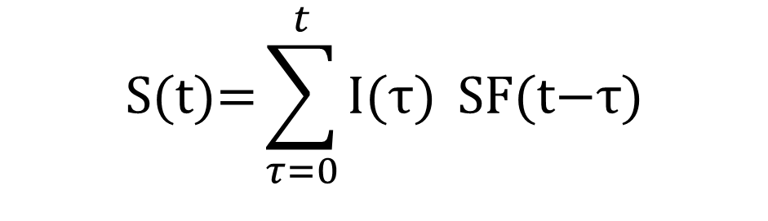

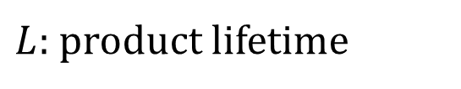
Lecture 3
$$\text{S(t)=}\sum_{τ=0}^{t}{\text{I(}\text{τ)} }\text{SF(t−}\text{τ)}$$
Input, output, and stock
$$\text{a=}\text{t−}\text{τ}$$
$$SF\left(a\right)=P\left(L>a\right)=1−F_{L}\left(a\right)$$
$L:$product lifetime
how many years has
the product been in use

Slide 46

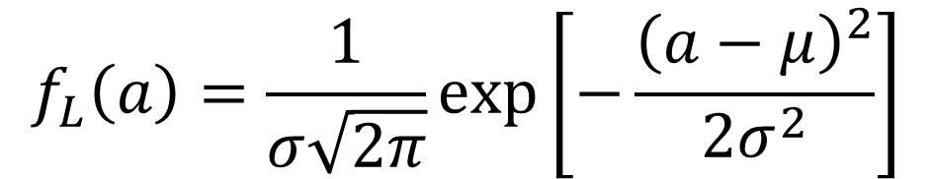
Lecture 3
Input, output, and stock
$$SF\left(a\right)=P\left(L>a\right)=1−F_{L}\left(a\right)$$
$$L∼N\left(μ,σ^{2}\right)$$
$$L∼\text{some lifetime distribution}$$
$$\boxed{F_{L}\left(a\right)=\int_{0}^{a}{f_{L}}\left(x\right) dx}$$
$$f_{L}\left(a\right)=\frac{1}{σ\sqrt{2π}}\exp\left[−\frac{{\left(a−μ\right)}^{2}}{2σ^{2}}\right]$$

Slide 47
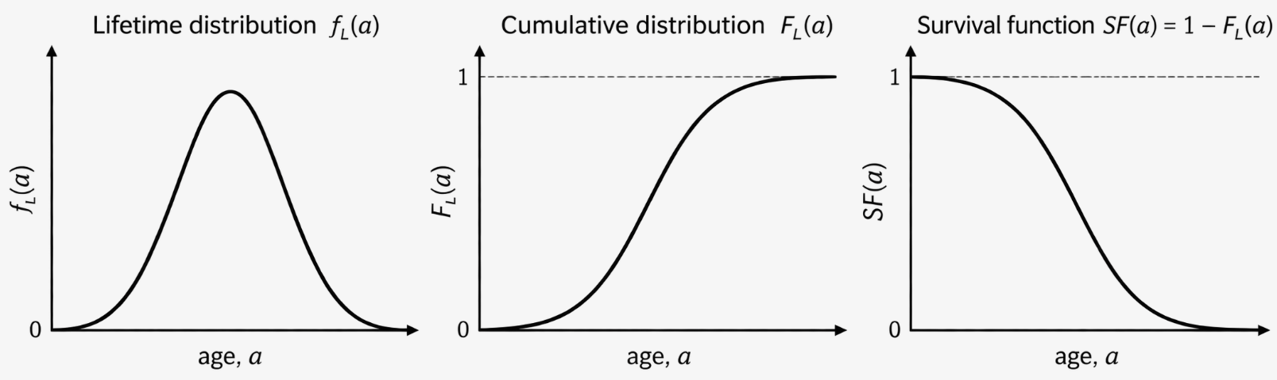
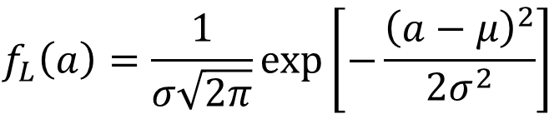
Lecture 3
Input, output, and stock
$$f_{L}\left(a\right)=\frac{1}{σ\sqrt{2π}}\exp\left[−\frac{{\left(a−μ\right)}^{2}}{2σ^{2}}\right]$$
$$SF\left(a\right)=P\left(L>a\right)=1−F_{L}\left(a\right)$$

Slide 48
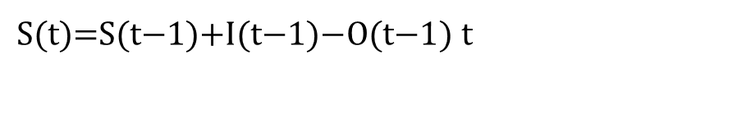




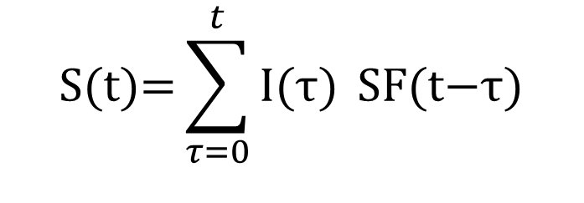
Lecture 3
Input, output, and stock
$$\text{I}\text{nflow}\underset{→}{\text{lifetime}}\text{Stock}\underset{→}{\text{mass balance}}\text{Outflow}$$
$$\text{I(}\text{τ)}$$
$$f_{L}\left(a\right)$$
$$F_{L}\left(a\right)$$
$\text{S(t)=S(t}\text{−1}\text{)+I(t}\text{−1}\text{)−O(t}\text{−1}\text{)}$ t
$$SF\left(a\right)$$
$$\text{S(t)=}\sum_{τ=0}^{t}{\text{I(}\text{τ)} }\text{SF(t−}\text{τ)}$$

Slide 49
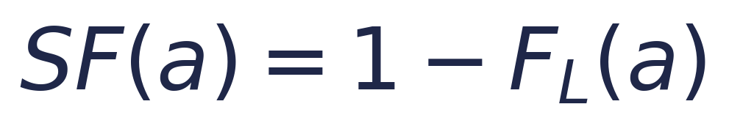

Lecture 3
Lifetime modelling
Exercise 1: Single-Cohort Lifetime Analysis
Scenario
Questions
In 2025, 100 Mt of steel enters society.
The cumulative lifetime function is given by:
1. What percentage of steel remains in use after 5 years?
2. How much steel remains after 10 years?
3. How much steel reaches end-of-life between ages 5 and 10?
Reminder
Learning goal: connect cumulative lifetime F_L(a), survival function SF(a), and remaining stock for a single production cohort.
49
Notes:
Instructor Notes – Exercise 1
Assumptions:
- Initial inflow in 2025 = 100 Mt.
- F_L(a) is the cumulative probability of reaching end-of-life by age a.
- SF(a) = 1 - F_L(a).
Step 1: Remaining share after 5 years
SF(5) = 1 - 0.20 = 0.80.
Remaining steel after 5 years = 100 × 0.80 = 80 Mt.
Step 2: Remaining steel after 10 years
SF(10) = 1 - 0.60 = 0.40.
Remaining steel after 10 years = 100 × 0.40 = 40 Mt.
Step 3: End-of-life flow between ages 5 and 10
Additional retirement share = 0.60 - 0.20 = 0.40.
Steel reaching end-of-life between ages 5 and 10 = 100 × 0.40 = 40 Mt.
Key takeaway:
- F_L(a) tells us how much has retired by age a.
- SF(a) tells us how much remains in use by age a.
- For a single cohort, remaining stock = inflow × survival.

Slide 50
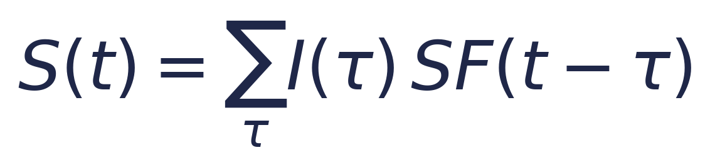
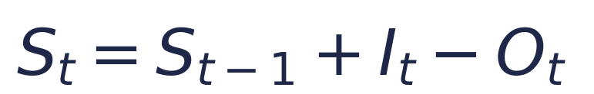
Lecture 3
Lifetime modelling
Exercise 2: Multiple Production Cohorts
Scenario
Questions
A country produces 10 Mt of aluminium each year from 2025 to 2028.
All production enters use immediately.
There is no retirement in the year of production.
1. How much of the 2025 cohort remains at the end of 2028?
2. What is the total aluminium stock at the end of 2028?
3. How much aluminium reaches end-of-life during 2028?
4. Verify the mass balance equation below.
Survival function
Age (a)
0
1
2
3
SF(a)
1.0
0.8
0.5
0.2
Use:
Check:
50
Notes:
Instructor Notes – Exercise 2
Assumptions:
- Annual inflow from 2025 to 2028 = 10 Mt.
- Survival function by product age: SF(0)=1.0, SF(1)=0.8, SF(2)=0.5, SF(3)=0.2.
- No retirement occurs in the production year.
Step 1: Remaining stock of each cohort at the end of 2028
- 2025 cohort has age 3 in 2028: 10 × 0.2 = 2 Mt.
- 2026 cohort has age 2 in 2028: 10 × 0.5 = 5 Mt.
- 2027 cohort has age 1 in 2028: 10 × 0.8 = 8 Mt.
- 2028 cohort has age 0 in 2028: 10 × 1.0 = 10 Mt.
Step 2: Total stock at the end of 2028
S_2028 = 2 + 5 + 8 + 10 = 25 Mt.
Step 3: Outflow during 2028
Compute stock at the end of 2027 first:
- 2025 cohort age 2: 10 × 0.5 = 5 Mt.
- 2026 cohort age 1: 10 × 0.8 = 8 Mt.
- 2027 cohort age 0: 10 × 1.0 = 10 Mt.
So S_2027 = 23 Mt.
Then O_2028 = S_2027 + I_2028 - S_2028 = 23 + 10 - 25 = 8 Mt.
Cross-check by cohort losses during 2028:
- 2025 cohort: 5 → 2, loss = 3 Mt.
- 2026 cohort: 8 → 5, loss = 3 Mt.
- 2027 cohort: 10 → 8, loss = 2 Mt.
Total outflow in 2028 = 8 Mt.
Key takeaway:
The stock in a given year equals the sum of surviving materials from all previous inflow cohorts.

Slide 51
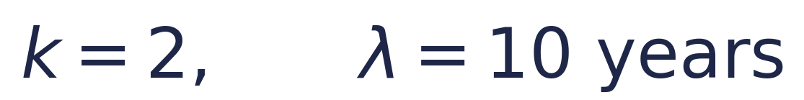
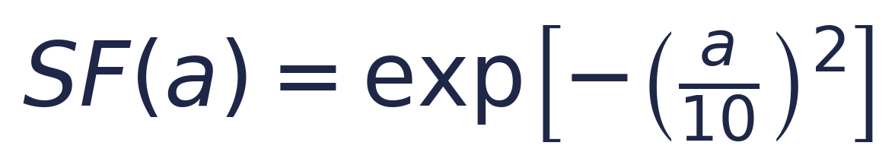
Lecture 3
Lifetime modelling
Exercise 3: Weibull Lifetime Distribution
Scenario
Questions
In 2025, 100 Mt of copper enters use in buildings.
Lifetime follows a Weibull distribution with:
1. What percentage remains in use after 5 years?
2. How much copper remains after 10 years?
3. How much copper reaches end-of-life between ages 5 and 10?
4. Why is a lifetime distribution more realistic than a fixed lifetime?
Formula
Hint: compute SF(5) and SF(10), then compare the surviving amounts.
51
Notes:
Instructor Notes – Exercise 3
Assumptions:
- Initial copper inflow in 2025 = 100 Mt.
- Weibull survival function: SF(a) = exp[-(a/10)^2].
Step 1: Remaining share after 5 years
SF(5) = exp[-(5/10)^2] = exp(-0.25) ≈ 0.7788.
So about 77.9% remains in use after 5 years.
Remaining copper after 5 years ≈ 77.9 Mt.
Step 2: Remaining copper after 10 years
SF(10) = exp[-(10/10)^2] = exp(-1) ≈ 0.3679.
Remaining copper after 10 years ≈ 36.8 Mt.
Step 3: End-of-life flow between ages 5 and 10
Copper reaching end-of-life between ages 5 and 10 = 77.9 - 36.8 ≈ 41.1 Mt.
Equivalent cumulative-retirement calculation:
F_L(5) = 1 - 0.7788 = 0.2212.
F_L(10) = 1 - 0.3679 = 0.6321.
Incremental retirement share = 0.6321 - 0.2212 = 0.4109.
Thus 100 × 0.4109 ≈ 41.1 Mt.
Step 4: Conceptual discussion
A lifetime distribution is more realistic than a fixed lifetime because products do not all retire at exactly the same age. Some fail earlier, some later, so a distribution captures heterogeneity in product lifetimes.
Key takeaway:
With a lifetime distribution and historical inflows, we can estimate both future stock and future end-of-life outflows.

Slide 52
Lecture 4
Static MFA Modeling with ODYM
Type | Meaning | Simple Explanation
Package | Collection of modules | A big toolbox containing smaller toolboxes
Module | Python code unit | A Python file (.py) containing tools
Subpackage | Package inside another package | A smaller toolbox inside a bigger toolbox
Class | Blueprint for creating objects | A template for creating tools or objects
Object | Instance of a class | An actual tool created from a class）
Attribute | Data stored in an object | Information or properties belonging to an object
Method | Function defined in a class | An action an object can perform
Function | Reusable block of code | An independent tool that performs a specific task

Slide 53
Lecture 4
Package
Static MFA Modeling with ODYM
Subpackage
Module
Module
Class
Object
Attribute
Method

Slide 54
ODYM (Package / Library)
│
└── classes (Subpackage, alias: msc)
│
├── Classification (Class)
│ └── Time, Element, Region (Example dimensions)
│
├── Process (Class)
│ └── p1 (Object) → Mining
│
├── Flow (Class)
│ └── f12 (Object) → Copper flow
│
├── Stock (Class)
│ └── s1 (Object) → Material stock
│
├── Parameter (Class)
│ └── par1 (Object) → Recovery rate
│
└── MFAsystem (Class)
└── mfa (Object)
├── IndexTable (Attribute: DataFrame)
├── ProcessList (Attribute: List)
├── FlowDict (Attribute: Dictionary)
├── StockDict (Attribute: Dictionary)
├── ParameterDict (Attribute: Dictionary)
└── MassBalance() (Method)
Lecture 4
Static MFA Modeling with ODYM

Slide 55
Lecture 4
Static MFA Modeling with ODYM
Step 1 | Model Definition: Building the MFA System
Step 1 | Code object | Purpose
1. Define classifications | msc.Classification (msc: material system model) | Specify the years and elements included in the model
2. Create the index table | IndexTable | Map model dimensions to index letters, such as t for time and e for element
3. Create the MFA system | msc.MFAsystem | Define the system name, spatial scope, units, and time boundaries
4. Add processes | msc.Process | Assign a name and ID to each process
5. Define flows | msc.Flow | Specify the origin, destination, and dimensions of each flow

Slide 56
Lecture 4
Static MFA Modeling with ODYM
Slide 2 | Model Implementation: Calculation and Validation
Step | Main task
6. Initialize arrays and enter data | Allocate flow arrays and specify inputs and parameters
7. Calculate and assign flows | Apply model equations and store results in FlowDict
8. Validate and visualize results | Check mass balances and present the calculated flows

Slide 57
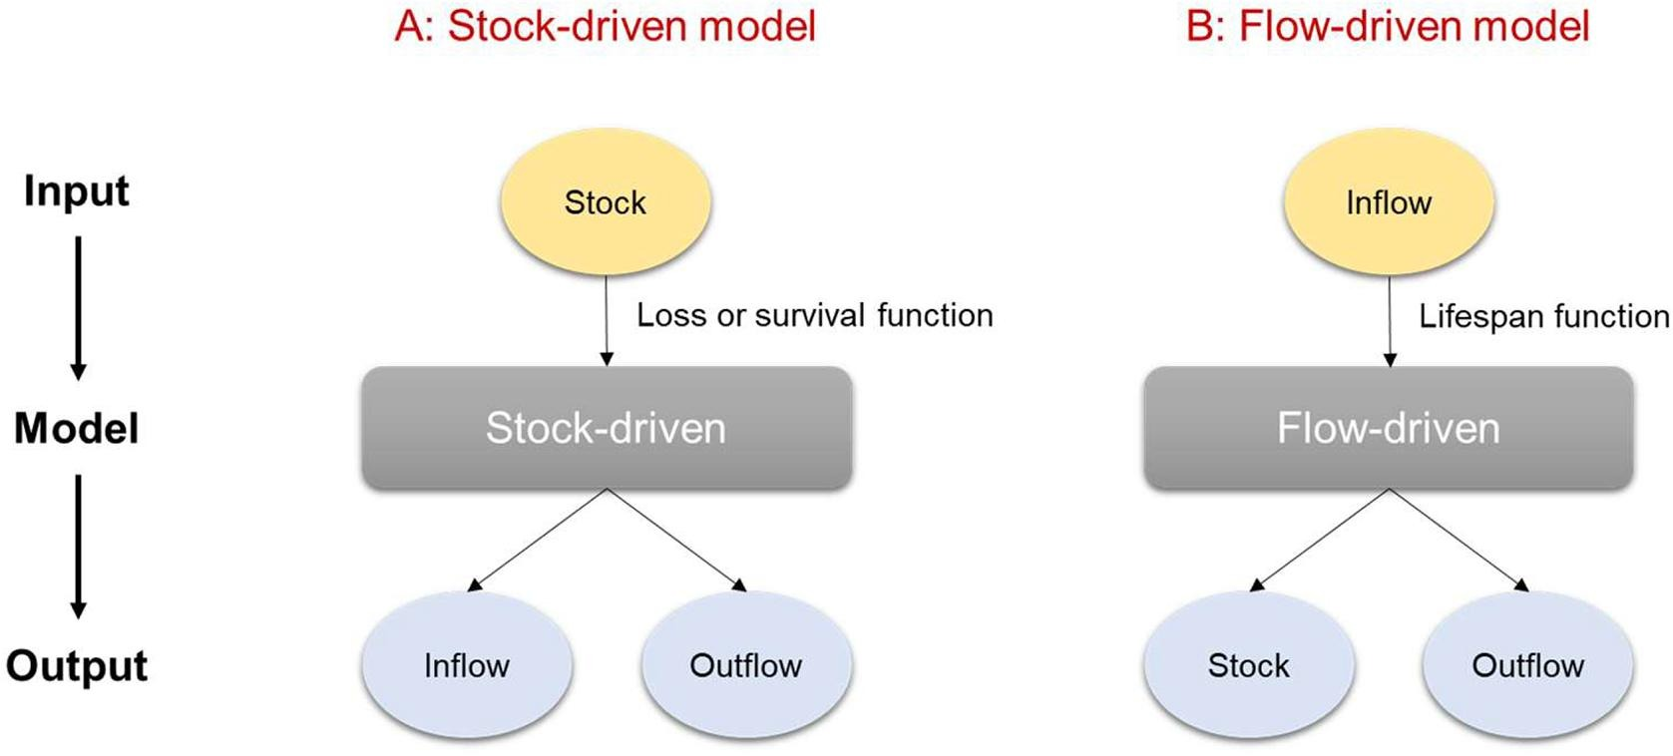
Lecture 5
Dynamic MFA
https://www.sciencedirect.com/science/article/pii/S1470160X23012402

Slide 58
Lecture 6
Dynamic MFA ODYM coding

Slide 59
Thank You

